Slide 1
ERA of LMOs for food, feed and processing in Japan
2013, 5, 24, Tokyo
ILSI Symposium on The Environmental Risk Assessment of Living
Modified Organisms Imported for Food, Feed and Processing
1, ERA system in Japan
2, ERA of Bt soybean
Shinobu SATOH
University of Tsukuba
Faculty of Life and Environmental Sciences
Notes:
I am serving as a head of sub-committee for ERA of GM crop in Japan.
But today’s talk is not on behalf of the committee, but from my personal understanding and opinion.
So, I would like to ask my colleagues to correct my misunderstandings when I made it.

Slide 2
Flow of assessment of Type 1 use in ERA committee in Japan
(Type 1 use = use without containment measures)
Data from laboratory or greenhouse
(in domestic or foreign lab.)
↓
Assessment
↓
Isolated field trial
↓
Data from isolated field in Japan
↓
Assessment
↓
Use for open field cultivation or commodity

Slide 3
Basic concepts of the assessment
・Scientific
→based on the primary information
published in peer-reviewed articles.
& on the case-by-case data of the
GM crops provided by applicants.
・Event based (≠ trait) : site-dependent effects
・Progeny lines are automatically approved
except for stacked lines.

Slide 4
ERA of stacked GM crops
= Hybrid between GMOs
by conventional breeding
  Possibility for Interaction between stacked traits is logically examined.
    NO：it can be assessed by ERA of their
    parents' events without additional
    field trial.
    YES：it will be assessed by the data from
    Isolated field trial of the stacked crop.

Slide 5
Categories of approval for Type 1 use
(except for isolated field trial)
1, Open field cultivation (anywhere in Japan)
2, Commodity use imported for processing or feed
a, without cultivation (ex. cotton)
    in case of no crossable wild plant
    nor no survival in Japanese nature
    b, with cultivation (ex. soybean)
    in case of presence of crossable wild plants
    or possible survival of spilled seeds
    during domestic transportation

Slide 6
Assessment items of GM crop
A) Crossability
Does it cross with relative wild plants?
→ Introgression?
B) Competitiveness
Does it decrease wild plant population?
C) Productivity of harmful substances
Does it influence on growth of wild animals/
plants/microbes ?

Slide 7
Points of the assessment in Japan
・1st step of ERA
Identification of the wildlife (plant) which
may be affected by GM crop.
*Wildlife (plant) is the non-crop species
which are native or have been introduced
before Meiji Era (1868) in Japan.
・Biodiversity is composed of
*Ecosystem diversity
*Species diversity in each ecosystem
*Genetic diversity in each species

Slide 8
Effects of gene transfer into wild population
= gene introgression
・Hybrid remains to be at low level
(trait without fitness: herbicide-tolerance)
→ no harm
・Hybrid increases in wild population
(trait with fitness: biotic/abiotic-stress
tolerance)
→ decreases genetic diversity in the population
→ harm

Slide 9
ERA for Bt soybean
cry1Ac, Glycine max (L) Merr.
(MON87701, OECD UI : MON-87701-2)
for cultivation submitted at March 31, 2010
by Monsanto Co.
  Target of cry1Ac : Lepidopteran insects (moth)
  Use : Import for processing or feed
1. Ordinary ERA for cultivation
with care for spillage growth
2. New type of ERA for import-only

Slide 10
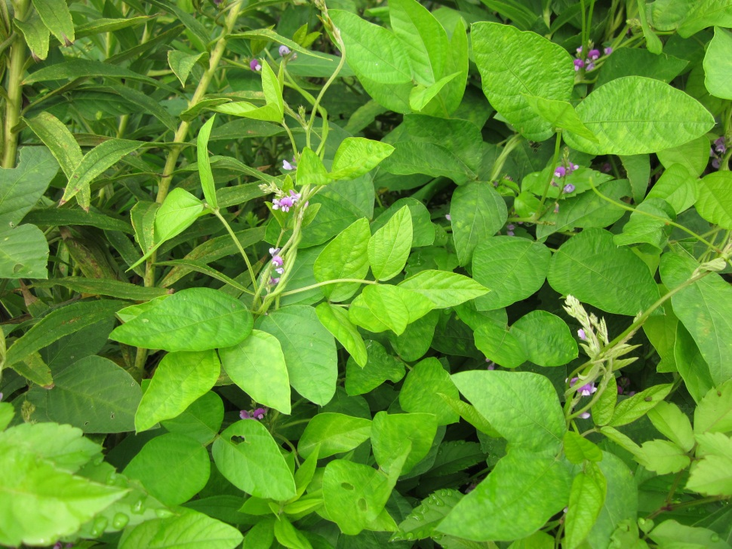
Wildlife which may be affected by Bt soybean (G. max)
Glycine soja (wild soy)
・Wild relative of soybean
(the origin of soybean)
grows in neighborhood.
・Their flowering time is slightly different,
but G. max and G. soja can be
crossed in low frequency.

Slide 11
Supposed effects (assessment endpoint)
of combination of host & trait
on the biodiversity in Japan
Host has | Compatible native-plant in Japan
Trait | Biotic/abiotic-stress tolerance
Effects on biodiversity | Hybrid between GM crop & native plant spreads in wild population of native plant ↓ Decrease in genetic diversity of the population
Example of crop | Soybean

Slide 12
ERA of Bt soybean for cultivation
・Evaluation of risk of out-crossing and
its consequence (gene introgression)
  Out-crossing rate : Less than 1 %*
  Survivability of hybrids between soybean
  and wild soy : Hybrids disappeared in one or
  two generations in natural habitat**
Literature
*Abe et al. 2001; Yoshimura et al. 2006, Nakayama & Yamaguchi 2002,
Mizuguti et al. 2009; Yoshimura 2008
**Kuroda et al. 2010

Slide 13
ERA of Bt soybean for cultivation
  c. Effect of insect damages on wild soy
  by Lepidopteran insects (moth)
    i. Field survey of insect damages
    ii. Defoliation study in greenhouse
    for pod and seed production
by Monsanto Co.

Slide 14

  Result of Field Survey of Wild Soy Populations
  in Ibaraki and Saga in 2011
Total
Grasshopper
Beetle
Moth
The survey was conducted in 2011 from Jun. 27 – Sep. 29 every two weeks at 23 individual observation areas.
The survey was conducted in 2011 from Jun. 29 – Oct. 6 every two weeks at 17 individual observation areas.
Feeding damage from Lepidopteran spp. was very low (＜2%) and lower than that from Orthopteran (＜20%) and Coleopteran spp (＜9%) in both Ibaraki and Saga.
However, the observation didn’t cover seedling stages in early spring.

Slide 15
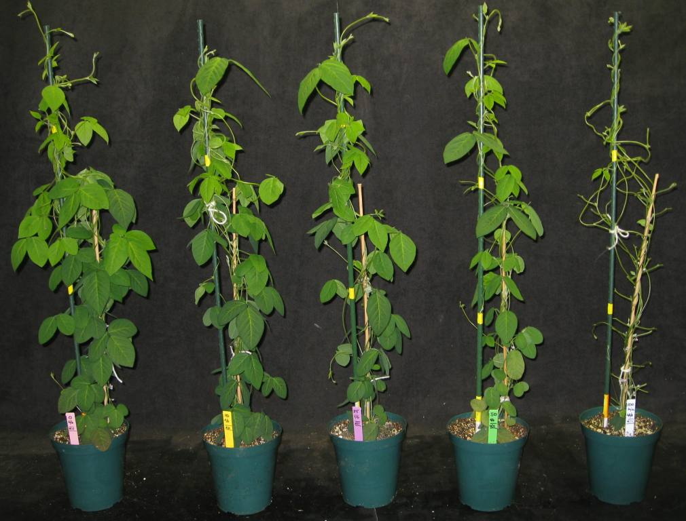
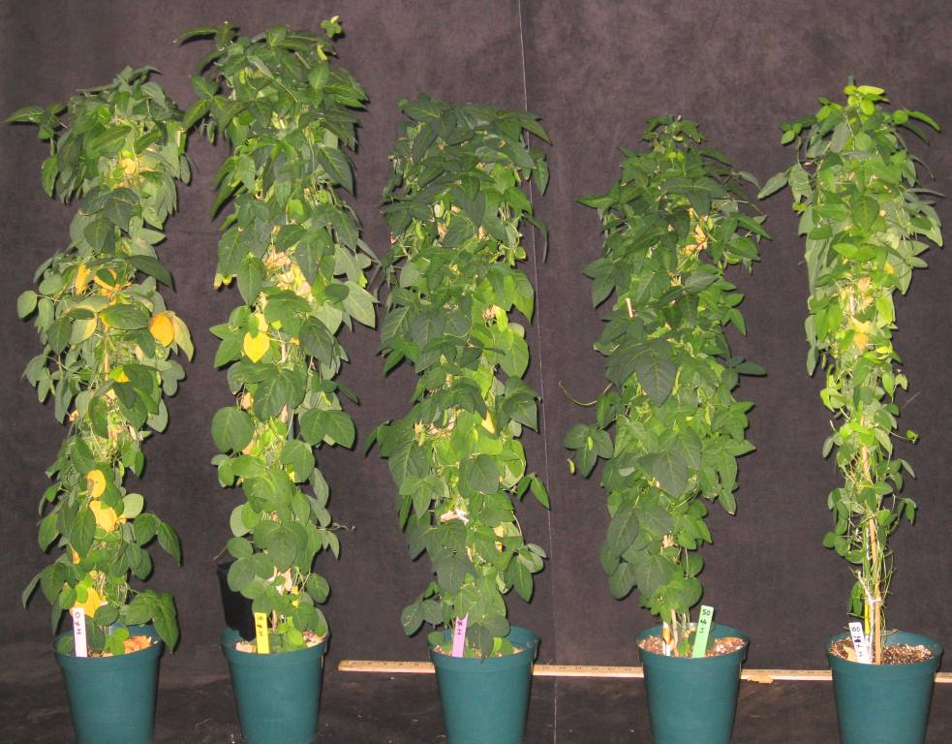
  Evaluation of Defoliation Effects on Wild Soy Pod and Seed Production
0
10
25
50
100
0
10
25
50
100
Wild soy plants after defoliation treatments at R1-R2 growth stage to simulate various levels of herbivory
Wild soy plants at R7 growth stage before harvest
Wild soy plants exhibited a strong compensation (as expected)
Wild soy was able to maintain high pod and seed production without a significant reduction at defoliation treatments up to 50% compared to no treatment

Slide 16
Conclusion of ERA for cultivation
1. Out-crossing rate between soybean and
wild soy is very low (< 1 %).
2. Hybrids between soybean and wild soy
disappeared in a wild soy population
in one or two generations.
3. Damages of wild soy by Lep. insects were
very low, much lower than threshold level
to reduce pod and seed production.
(but, the observation time didn’t cover
seedling stage.)

Slide 17
4. In Japan, even in case of import-only,
approval for cultivation is required
because of care for spillage of seed
during transportation.
5. “Approval for cultivation” means
no limitation of cultivation in terms of place
and period in Japan.

Slide 18
6. Field trial for assessment of the risk of gene
introgression in long term is very hard
in current regulation system,
because cultivation of BT-soybean with wild
soy in trial field cannot be approved.
7. It is hard to demonstrate that
gene introgression wouldn’t happen under
any cultivation in current situation, so
approval for cultivation was impossible.

Slide 19
8. To change the assesssment
from “for cultivation” to “for import-only”,
it has been necessary to introduce
new ERA system with consideration
for exposure level .
↓
cry1Ac, Glycine max (L) Merr.
(MON87701, OECD UI : MON-87701-2)
for import-only submitted at July 13, 2012
by Monsanto Co.

Slide 20
ERA of Bt soybean for import-only
Evaluation of exposure level in import of Bt
soybean to understand risk of gene introgression
  a. Food grade soybean is transported in bags, but
  feed use soybean is transported by
  big box-truck. → spillage
  b. MAFF reported the number of soybean plants
  grown along roadside from spilled seeds
  during transportation within 5 km from
  unloaded ports.

Slide 21
MAFF’s Report on the Number of Soybean Plants
Observed around Ports (< 5 km)
＊Soybean is unloaded only from the restricted ports in Japan
Ports | Number of soybean plant (Number of GM soybean) |  | Average | 95% confidential level
 | 2009 | 2010 |  | Lower limit | Upper limit
Tomakomai | 0 (0) | 2 (1) | 1.0 | 0.24 | 5.57
Kashima | 3 (2) | 0 (0) | 1.5 | 0.24 | 5.57
Chiba | 1 (0) | 0 (0) | 0.5 | 0.03 | 3.69
Tokyo | 0 (0) | 0 (0) | 0.0 | 0.00 | 3.69
Yokohama | 0 (0) | 0 (0) | 0.0 | 0.00 | 3.69
Shimizu | 0 (0) | 0 (0) | 0.0 | 0.00 | 3.69
Nagoya | 0 (0) | 0 (0) | 0.0 | 0.00 | 3.69
Kobe | 2 (0) | 0 (0) | 1.0 | 0.24 | 5.57
Mizushima | 0 (0) | 0 (0) | 0.0 | 0.00 | 3.69
Hakata | 10 (0) | 6 (4) | 8.0 | 3.45 | 15.76

Slide 22
ERA of Bt soybean for import-only
Evaluation of exposure level of import of Bt
soybean to understand risk of gene introgression
c. Possible routes for maximum number of spilled
  seeds were determined.
  d. GIS survey on the condition of roadsides was
  made to estimate probability of growth of soybean
  from spilled seeds and wild soy.
  e. Estimation was made on maximum number of
  hybrids seeds produced in wild soy population
  along roadside from an unloaded port to an inland
  feed factory.

Slide 23
© パスコ
© パスコ
Ground with plants
Garden
Paddy, Upland fields
Ground without plant
River sides
Street plants
（Distance from road = 10 ｍ）

Slide 24
Factors used for estimating maximum number
of Bt soybean hybrids seeds (highest case)
1, No. of spilled seeds from a truck during
transportation: 50 % reduction every 5 km.
2, Probability of the spilled seeds to grow along
roadside : 5– 100 % (depend on roadside
conditions from GIS).
3, Maximum probability of hybrid seeds : 6.25 %
(1 hybrid seed was produced from 16 wild soy plants
twisted around a soybean plant*).
*Mizuguti et al. (2009)

Slide 25
Probability of Spilled Seeds
to Grow along Roadsides
Area | Category | Probability
 |  | (A) Soybean can grow | (B) Wild soy is native (within area where soybean can grow)
1 | River sides | 1 | 0.5
2 | Grounds with plants | 1 | 0.3
3 | Garden | 0.3 | 0.1
4 | Park and stadium with grass | 0.3 | 0.05
5 | Center dividers | 0.3 | 0.05
6 | Street plants | 0.3 | 0.05
7 | Levees of paddy and upland fields | 0.05 | 0.025
8 | Forests | 0.05 | 0.025
9 | Ground without plant (athletic field, well-managed parking) | 0.05 | 0.01
Area1 x 1 + Area2 x 1 + Area3 x 0.3 + …… = Soybean growing area（X）
Area1 x 0.5 + Area2 x 0.3 + Area3 x 0.1 + ……= Wild soy growing area（Y）
Probability that Bt soybean plants grown near wild soy = Y/X (0.241 in 0-5 km)

Slide 26
Number of Hybrid Seeds Produced Along Roadside Between an Unloaded Port and a Feed Factory
Distance from the port | A | B | C (= A×B) | D (= C×0.06)
 | Number of Bt soybean plants grown from spilled seeds | Probability that Bt soybean plants grown near wild soy | Number of Bt soybean plants grown near wild soy | Number of hybrid seeds produced in wild soy populations
0-5km | 12.13* | 0.241 | 2.92 | 0.18
5-10km | 6.07 | 0.295 | 1.79 | 0.11
10-15km | 3.03 | 0.5 (not examined) | 1.52 | 0.09
15-20km | 1.52 | 0.5 | 0.76 | 0.05
20-25km | 1.00 (minimum) | 0.5 | 0.50 | 0.03
25-30km | 1.00 | 0.5 | 0.50 | 0.03
30-35km | 1.00 | 0.5 | 0.50 | 0.03
35-40km | 1.00 | 0.5 | 0.50 | 0.03
40-45km | 1.00 | 0.5 | 0.50 | 0.03
45-50km | 1.00 | 0.5 | 0.50 | 0.03
50-55km | 1.00 | 0.5 | 0.50 | 0.03
55-60km | 1.00 | 0.5 | 0.50 | 0.03
60-65km | 1.00 | 0.5 | 0.50 | 0.03
65-66km | 1.00 | 0.5 | 0.50 | 0.03
Total |  |  | 11.99 | 0.75
Case of Hakata Port
*The number of soybean plants grown from spillage during transportation relates to amount of soybean grains transported to each feed factory. Two feed factories use Hakata port and the amount of soybean transported to the factories is 500 ton and 150 ton. Therefore, the number of soybean plants grown from spillage for larger transportation is calculated as 15.76 x 500/650 = 12.13.（per a factory)

Slide 27
Estimation of maximum number
of Bt soybean hybrids seeds (highest case)
1, The estimated maximum number of hybrid seeds
was 0.75.
2, Maximum probability of hybrid seeds to produce
next generation’s seeds was 0.20 % (1 plant was
produced from 488 hybrid seeds**).
3, Maximum number of hybrid seeds
which can produce next generation seeds
was 0.0015 (= 0.75 x 0.002).
**Estimation using data from Mizuguti (2009)

Slide 28
Conclusion for assessment of Import-only
1, Risk of gene introgression of
Bt-gene in wild soy population is
very low and the risk is acceptable.
2, ”Import of BT-soybean without cultivation”
can be approved.
3, Monitoring of Bt soybean and wild soy will
be required at three routes of the highest
probability to check the presence of Bt
soybean and hybrid between Bt soybean
and wild soy.

Slide 29
ERA for Bt soybean
cry1Ac, Glycine max (L) Merr.
(MON87701, OECD UI : MON-87701-2)
for import-only submitted at July 13, 2012
by Monsanto Co.
has been approved at Feb 25, 2013
under the new type of ERA for import-only
in Japan.
Monitoring of Bt soybean and wild soy
was requested.

Slide 30
Comments from ERA committee members
・All imported soybean is desirable to be
domestically transported with rigid container
without spillage.
・Studies with compatible wild relatives
is desirable to be conducted by the company
during the development of GM crops
which have enhanced fitness.

Slide 31
Thank you.
Acknowledgements:
・Monsanto Company
・ERA committee members
・MAFF/MOE office

